Slide 1
Loader

Slide 2
Loader & its Functions
A loader is a system program, which takes the executable code of a program as input and prepares it for execution.
many also support relocation & linking
others have a separate linker and loader
Basic Functions
bringing an object program into memory
starting its execution
Notes:
Loader is a system program that loads machine codes of a program into the system memory.
Loading a program involves reading the contents of executable file into memory.
Once loading is complete, the operating system starts the program by passing control to the loaded program
<number>

Slide 3
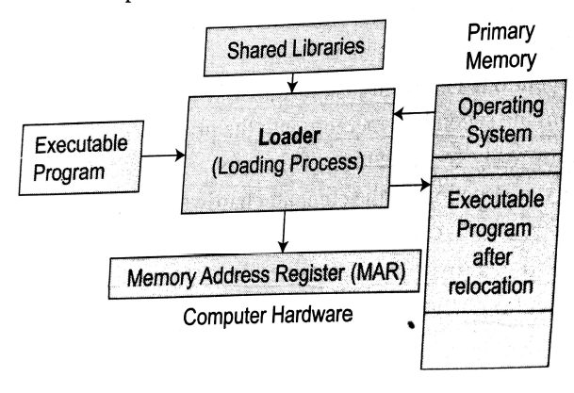
A Simple Loading Process
Notes:
Srimanta Pal Page No: 406
<number>

Slide 4
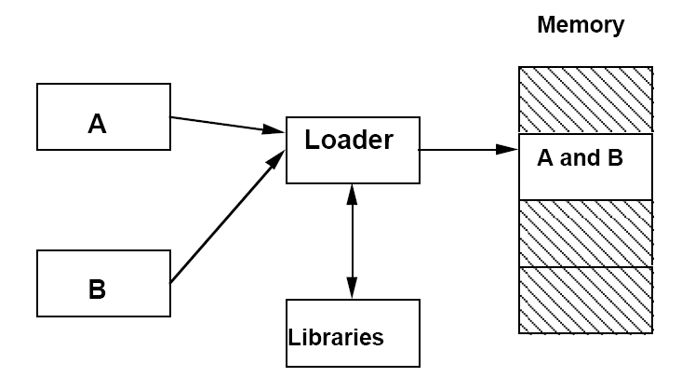
Loading Process with Linking
<number>

Slide 5
Loading object code into memory
Object code file (disk)
Run time environment
Header
Program name: start
Starting address text: x200
Length of text in bytes: x14
Starting address data: x20A
Length of data in bytes: 8
0001000000001001
0010000000001001
0011000000000111
0001000000001000
0100000000001000
0011000000000110
1001000000000000
1000111111111000
0001000000000001
0111000000000000
0000000000000000
0000000000000101
0000000000000011
0000000000000001
Text
Data
Heap
Text section
Data section
Stack

Slide 6
Loader & its Functions
Loader Function : The loader performs the following functions :
Allocation - The loader determines and allocates the required memory space for the program to execute properly.
Linking -- The loader analyses and resolve the symbolic references made in the object modules.
Relocation - The loader maps and relocates the address references to correspond to the newly allocated memory space during execution.
Loading - The loader actually loads the machine code corresponding to the object modules into the allocated memory space and makes the program ready to execute.
Notes:
Allocation: allocate space in memory for the programs
Linking: Resolve symbolic references between object files
combines two or more separate object programs
supplies the information needed to allow references between them
Relocation: Adjust all address dependent locations, such as address constants, to correspond to the allocated space
modifies the object program so that it can be loaded at an address different from the location originally specified
Loading: Physically place the machine instructions and data into memory
<number>

Slide 7
STEPS INVOLVED IN LOADING
Executable file’ s header is read to determine the size of text and data segments.
Instructions and data are copied into address space.
Arguments passed to the program are copied on the stack
Machine registers including the stack pointer are initialized.
The control is transferred to a start-up routine that copies the program’ s arguments from the stack to registers and calls the program’ s main routine.

Slide 8
Types of Loaders
Type of loaders
Compile-and-go loader
absolute loader (bootstrap loader)
relocating loader (relative loader)
direct linking loader
General Loader Scheme

Slide 9
Compile and Go Loader
In compile and go loader is a link editor/program loader in which the assembler itself places the assembled instruction directly into the designated memory locations for execution.
The assembler run in one part of memory
Place the assembled machine instructions and data, as they are assembled, directly into their assigned memory locations
When the assembly is completed, the assembler causes a transfer to the starting instruction of the program
Compilation, assembly, and link steps are not separated from program execution, all in single pass.
The intermediate forms of the program are generally kept in RAM, and not saved to the file system.
Also called an assemble-and-go or a load-and-go system
<number>
Notes:
The instruction are read line by line, its machine code is obtained and it is directly put in the main memory at some known address.
The assembler is first executed and it, when it is finished, causes a branch straight to the first instruction of the program.
There is no stop between the compilation, link editing, loading, and execution of the program.
It is also called an assemble-and-go or a load-and-go system
Suppose the starting address of allocated primary memory is A. The Source Program Psis translated into object Program Po by the compile & go Loader and store into the primary memory starting A. At the end of translation, the address A is stored into the Memory Addresss register (MAR ) or Program Counter for Execution.
<number>

Slide 10
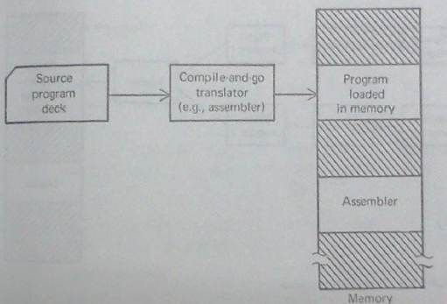
Compile and Go Loader

Slide 11
Advantages and Disadvantages
Advantages of Compile-and-go loaders:
Simple and easier to implement.
No additional routines are required to load the compiled code into the memory.
Disadvantages of Compile-and-go loaders:
Wastage of memory space due to the presence of the assembler.
There is a need to re-assemble the code every time it is to be run.
It becomes increasingly difficult to handle large number of segments when the input code is written in a variety of HLL say one routine in Pascal and one in FORTRAN and so on.
Such loader make designing modular programs and systems near impossible.
Notes:
There is no production of object file, the source code is directly converted to executable form. Hence even though there is no modification in the source program it needs to be assembled and executed each time.
Systems with multiple modules, possibly in different languages, cannot be handled naturally within this framework.
Compile-and-go systems were popular in academic environments, where student programs were small, compiled many times, usually executed quickly and, once debugged, seldom needed to be re-executed.
<number>

Slide 12
General Loader Scheme
In “Compile-and-Go” the outputting instruction and data are assembled. In which assembler is placed in main memory that results in wastage of memory.
To overcome that we requires the addition of the new program of the system, a loader.
Generally the size of loader is less than that of assembler.

Slide 13
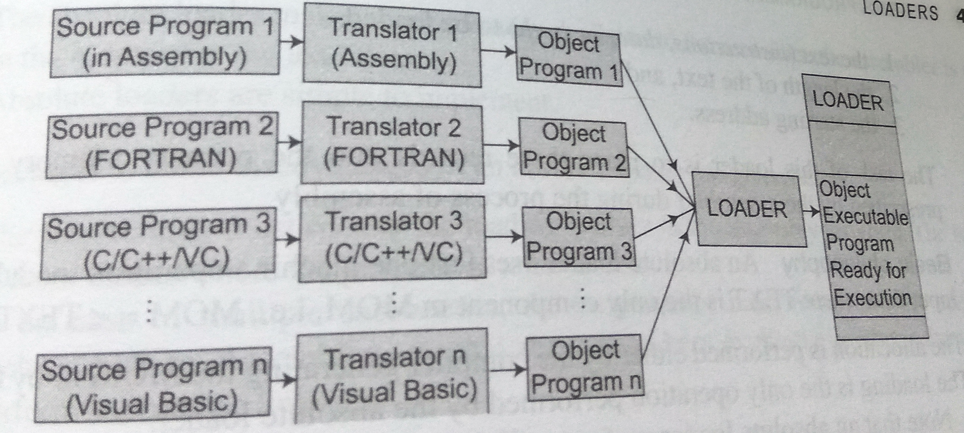
General Loader Scheme

Slide 14
Advantage of General Loader Scheme
In this scheme the source program translators produce compatible object program deck formats and it is possible to write subroutines in several different languages since the object decks to be processed by the loader will all be in the same “language” that is in “machine language”.

Slide 15
Absolute Loader

Slide 16
Design of an Absolute Loader
Its operation is very simple
no linking or relocation
Single pass operation
check H record to verify that correct program has been presented for loading
read each T record, and move object code into the indicated address in memory
at E record, jump to the specified address to begin execution of the loaded program.
10/21/2007
<number>

Slide 17
ABSOLUTE LOADER
Absolute loader loads the object code to specified locations in the memory.
At the end the loader jumps to the specified address to begin execution of the loaded program.
ADVANTAGES : Simple and efficient.
DISADVANTAGES :
The need for programmer to specify the actual address.
Difficulty in using subroutine libraries.

Slide 18
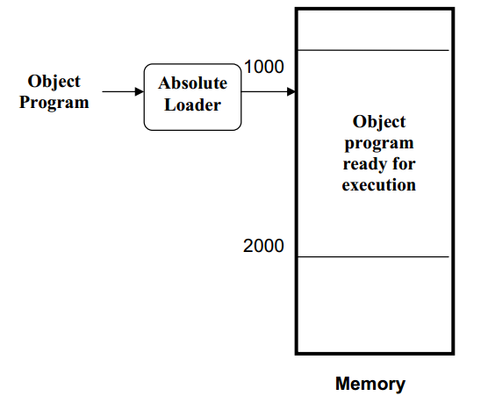
ROLE OF ABSOLUTE LOADER

Slide 19
Absolute Loader
Assembler object code file
Absolute loader:
The absolute loader will load the
program at memory location x200:
1.- The header record is checked to
verify that the correct program has
been presented for loading.
2.- Each text record is read and
moved to the indicate address in
memory
3.- When the “end” record (EOF) is
encountered, the loader jumps to the
specified address to begin execution.
Program name: start
Starting address text: x200
Length of text in bytes: x14
Starting address data: x20A
Length of data in bytes: 8
0001000000001001
0010000000001001
0011000000000111
0001000000001000
0100000000001000
0011000000000110
1001000000000000
1000111111111000
0001000000000001
0111000000000000
0000000000000000
0000000000000101
0000000000000011
0000000000000001
Header
Text section
Data section
Notes:
<number>

Slide 20
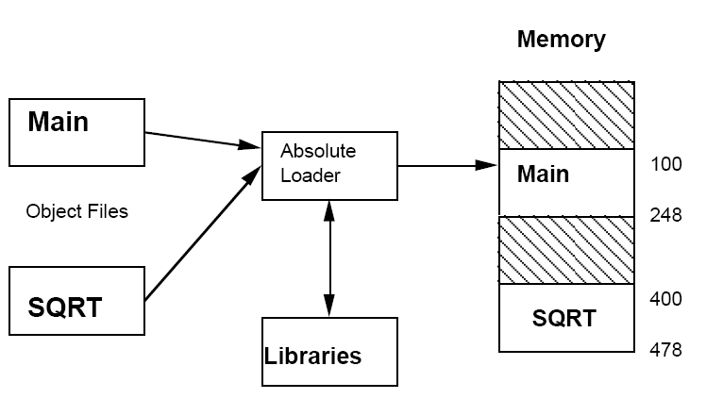
Absolute Loader
10/21/2007
Dr. Monther Aldwairi
<number>
Notes:
The MAIN program is assigned to locations 100-247 and the SQRT subroutine is assigned locations 400-477. if changes were made to MAIN that increasing length to more than 300 bytes.
The end of MAIN is overlap with the start of SQRT. It would then necessary to assign SQRT to a new location by changing its START.
Furthermore, it would also be necessarily to modify all other subroutines that referred to the address of SQRT.
<number>

Slide 21
Absolute Loader
The Loader accept translated form in form of Image Consisting:
The Text(Instruction & Data both)
The Length of Text
The Starting Address
Advantages of Absolute Loader:
Simple, easy to design and implement.
Since more core memory is available to the user there is no memory limit.
Disadvantages of Absolute Loader:
Actual load address must be specified
The programmer must be careful not to assign two subroutines to the same or overlapping locations

Slide 22
Bootstrap Loader
Special Type of Absolute Loader.
When a computer is first tuned on or restarted bootstrap loader is executed.
This bootstrap loads the first program to be run by computer that is the OS.
It loads the first address 0x80.

Slide 23
Bootstrapping continued…
This program does not have the full functionality of an operating system, but it is capable of loading into memory a more elaborated software (i.e. loader2) which in its turn will load the operating system.
Once the OS has been loaded the loader transfers the control of the computer system to the operating system.
Notes:
Early programmable computers had toggle switches on the front panel to allow the operator to place the bootloader into the program store before starting the CPU.
In modern computers the bootstrapping process begins with the CPU executing software contained in ROM at a predefined address whose elementary functionality is to search for devices eligible to participate in booting, and load a small program from a special section of a device.
<number>

Slide 24
Relocating Loaders
To avoid possible reassembling of all subroutines when a single subroutine is changed and to perform the tasks of allocation and linking for the programmer the relocating loaders is introduced.
The execution of the object program is done using any part of the available & sufficient memory.
The object program is loaded into memory wherever there is room for it.
The assembler assembles each procedures segment independently and passes to loader the text and information as to relocation and intersegment references.
The assembler would also provide the loader with additional information, such as the length of the entire program and the length of the transfer vector.
<number>

Slide 25
Practical relocating loader
BINARY SYMBOLIC SUBROUTINE (BSS) loader such as used in the IBM 7094,IBM 1130,GE 635.
The output of the relocating assembler using a BINARY SYMBOLIC SUBROUTINE(BSS) scheme is the Object program and information about all other program its references.
The BSS loader allows many procedure segments but only one data (common)segment.
The BSS loader scheme is often used on computers with a fixed-length direct address instruction format.
Loaders
<number>

Slide 26
Practical relocating loader
Advantages ::
Avoids possible reassembling of all Subroutines when a single Subroutine is changed
Perform the tasks of allocation and linking for the programmer.
Disadvantages ::
Difficult to implement
Algorithm is depends on File structure of the object program.
Slower than Absolute loader
Loaders
<number>

Slide 27
Direct Linking Loaders
A Direct linking loader is a general relocating loader and is the most popular loading scheme presently used.
This scheme has an advantage that it allows the programmer to use multiple procedure and multiple data segments.
In addition, the programmer is free to reference data or instructions that are contained in other segments.
The direct linking loaders provide flexible intersegment referencing and accessing ability.

Slide 28
Direct Linking Loaders
The assembler should give the following information to the loader:
1)The length of the object code segment
2)The list of all the symbols which are not defined in the current segment but can be used in the current segment.
3)The list of all the symbols which are defined in the current segment but can be referred by the other segments.

Slide 29
USE Table
USE Table
The list of symbols which are not defined in the current segment but can be used in the current segment are stored in a data structure called USE table.
The USE table holds the information such as name of the symbol, address, address relativity.

Slide 30
Definition Table
The list of symbols which are defined in the current segment and can be referred by the other segments are stored in a data structure called DEFINITION table.
The definition table holds the information such as symbol, address.

Slide 31
Direct Linking Loaders
Object deck:
The Object Deck is used by various IBM 360 or 370 Direct Linking Loaders.
There are 4 Sections of Object Desk :
1: External Symbol Dictionary cards(ESD).
2: Instruction and Data Cards, called “TEXT” of Program (TXT).
3: Relocation and Linkage Directory cards (RLD).
4: END card (END).

Slide 32
ESD card
The ESD cards contain the information necessary to build the external symbol dictionary or symbol table.
External symbols are symbols that can be referred beyond the subroutine level.
There are 3 types of external symbols:
1: Segment Definition (SD).
2: Local Definition (LD).
3: External Reference (ER).

Slide 33
Global External Symbol Table(GEST):
The GEST is used to store the external symbols defined by means of segment definition or local definition or an External Symbol Dictionary(ESD) card.
When these symbols are encountered during Pass 1, they are assigned an absolute core address; this address is stored along with the symbol in GEST.
The reader may wish to review the discussion on symbol tables and searching/sorting techniques in conjunction with the design of an assembler.
The GEST has the same general use and characteristics as the assembler’s Symbol Table.

Slide 34
From Assemblers & Compilers
Copy of Object
Decks
Loader
Pass 1
Loader
Pass 2
External Symbol Table
Input Object checks

